Slide 1
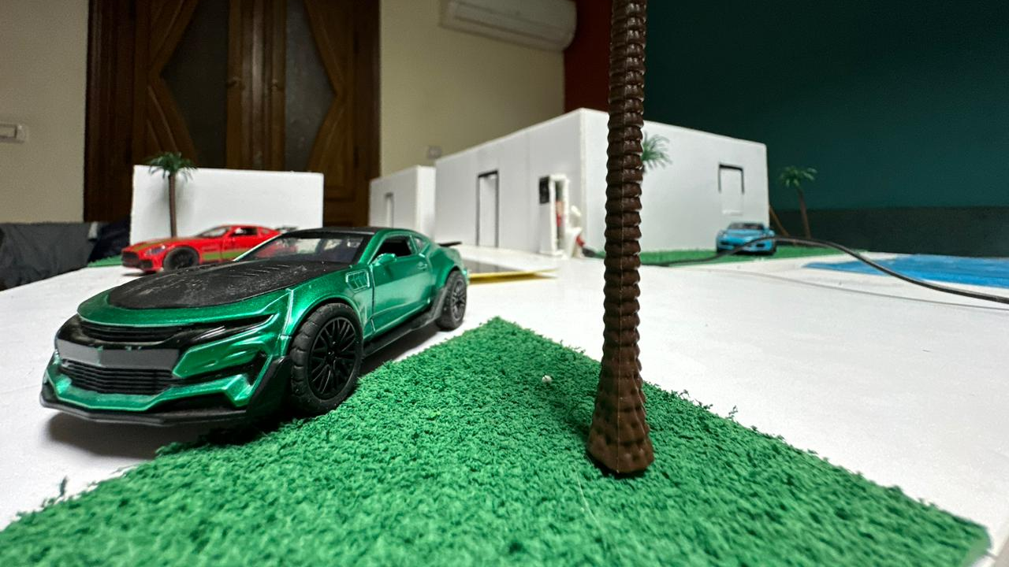
Graduation Project “Smart City Automation System”

Slide 2

Tracks
Collect Data
Embedded Systems
Control Actions
Communication
Replacing the local network
Data Storage
Cloud
Remote Access
Data Processing

Slide 3
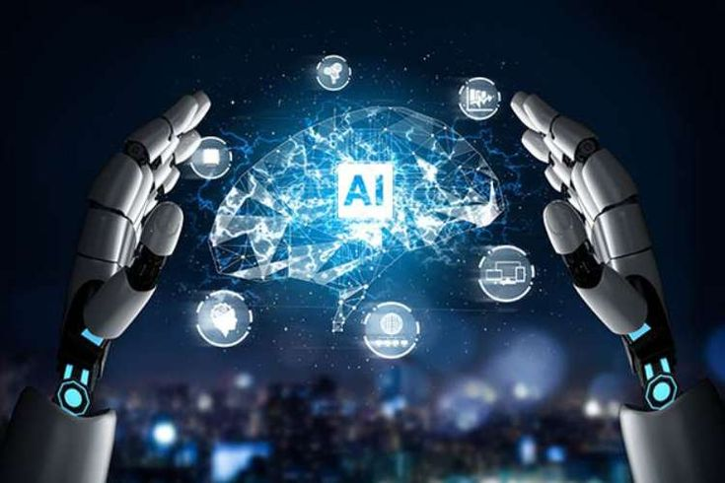

Tracks
AI
Smart Decision-Making
Pattern Recognition
Monitor
Mobile Application
with IoT devices
control

Slide 4
PCB
Schematic
Proteus
PCB Printing
Circuit Implementation

Slide 5
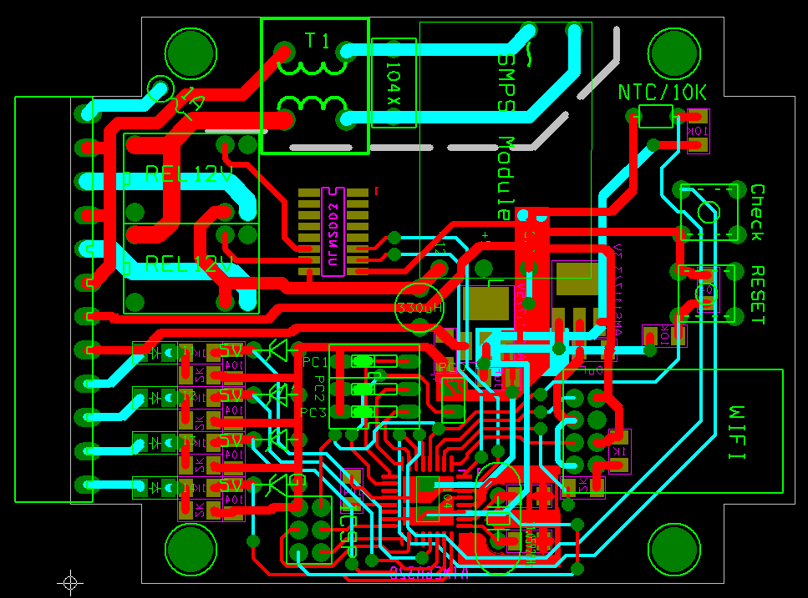
Proteus

Slide 6
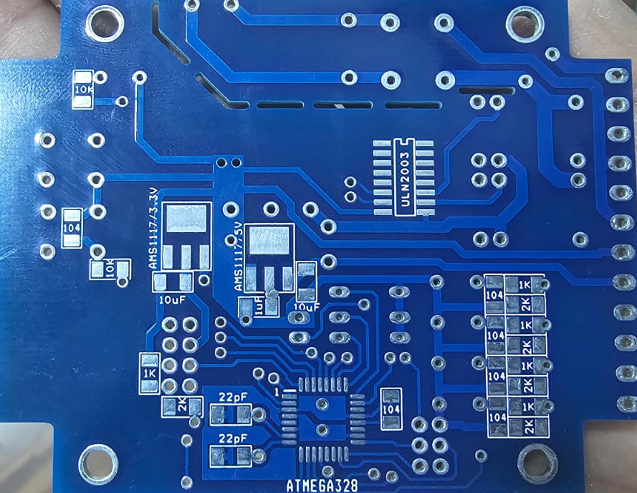
PCB Printing

Slide 7
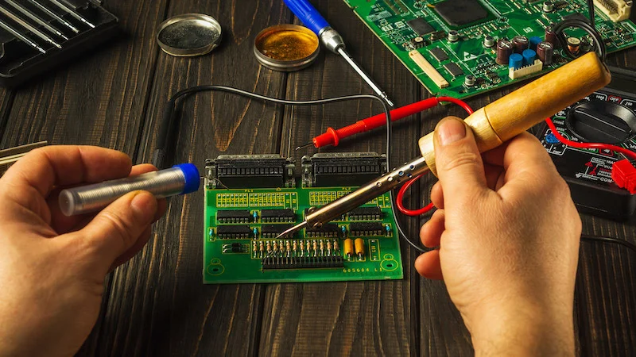
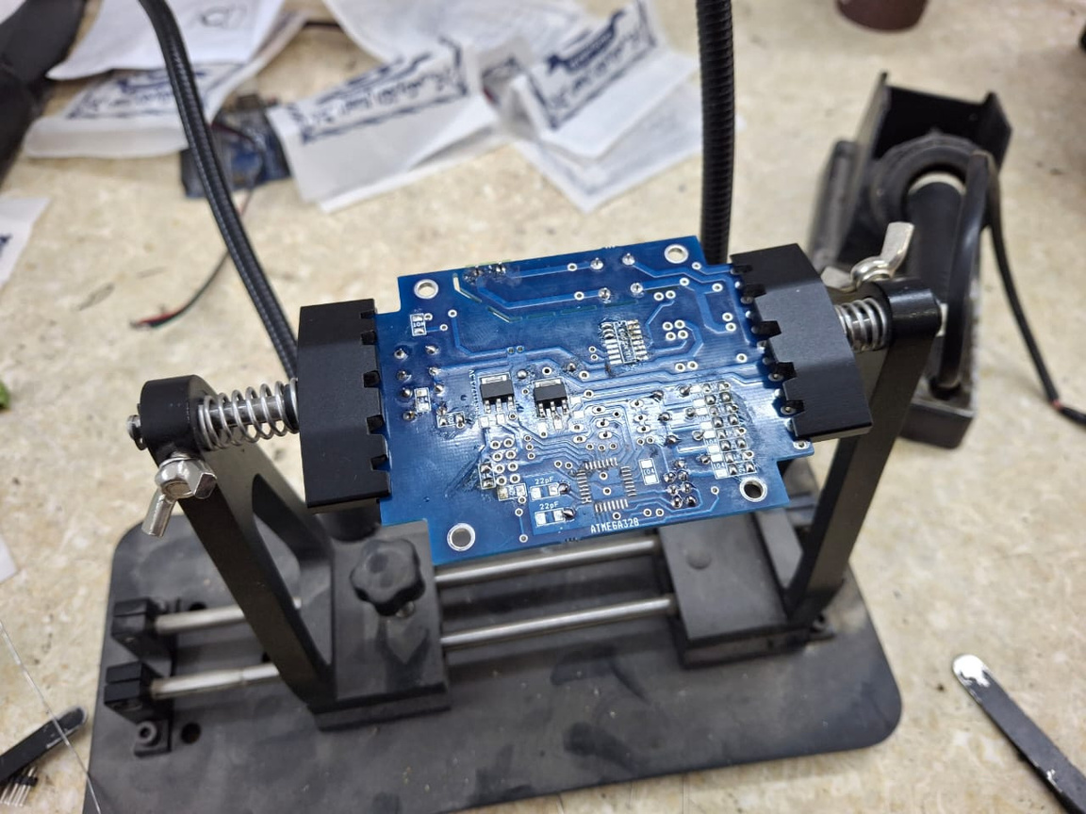
Circuit Implementation

Slide 8
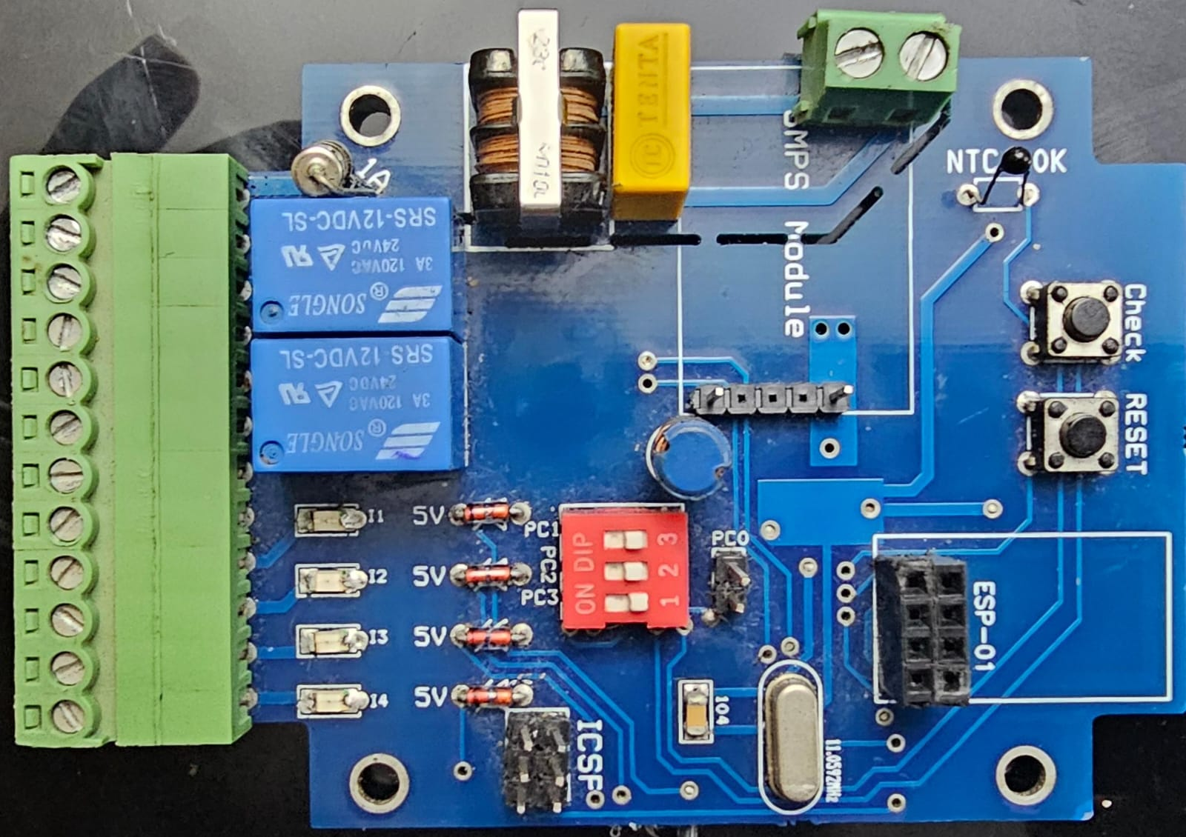
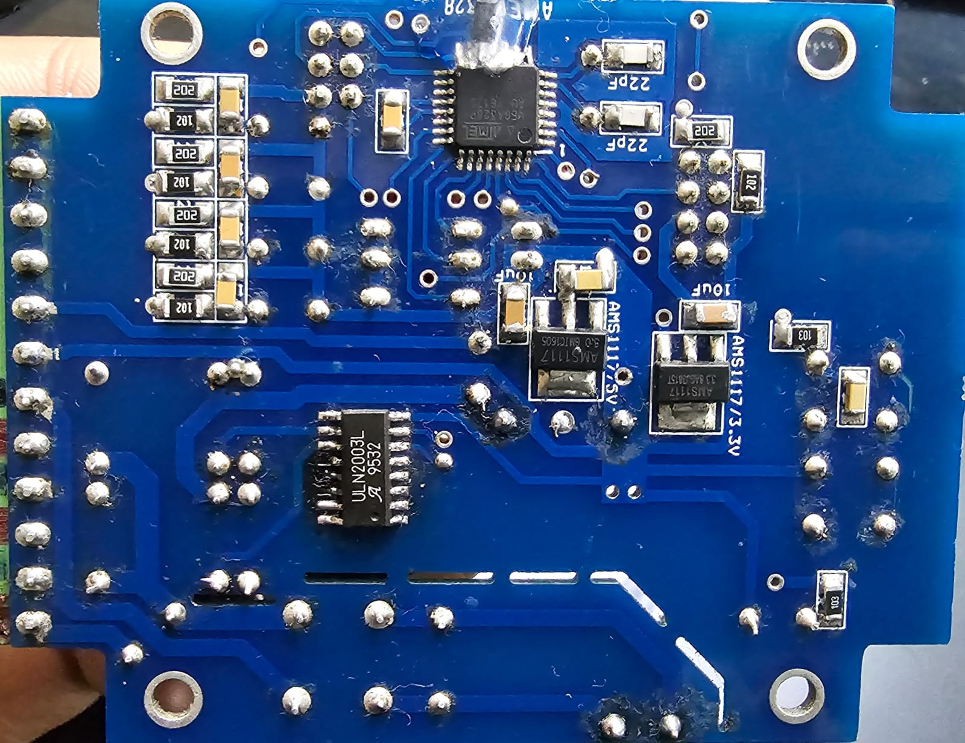
Final result

Slide 9
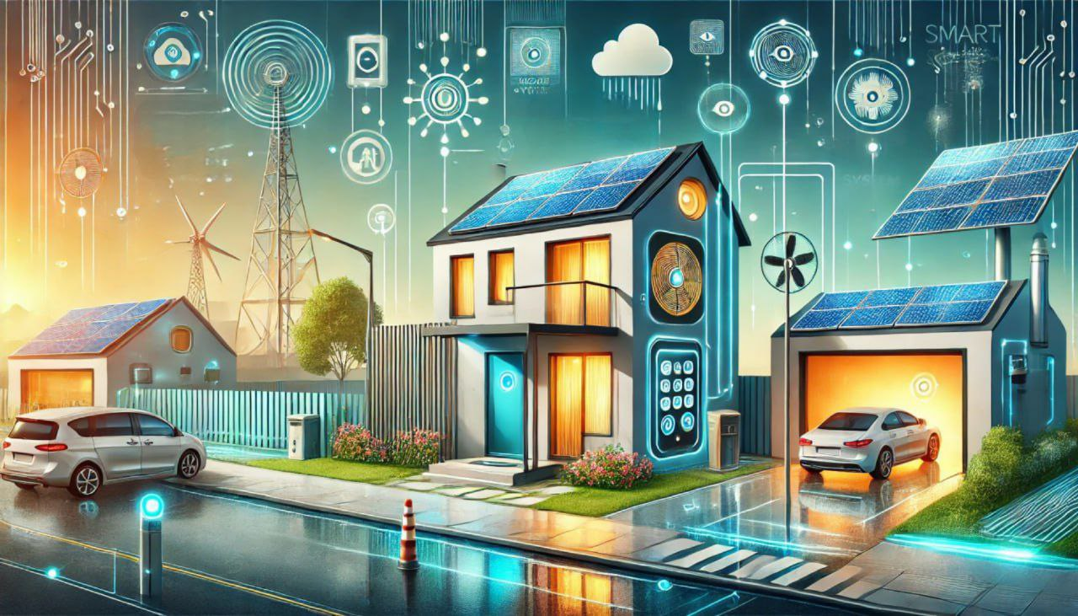
Agenda
1- Smart Door Access Control
2- Rain Guard System
3- Smart Gas Detection
4- AutoCooling System
5- SolarSmart Lighting
6- Face recognition
7- Car detection
8- Car counter

Slide 10

Overview of Key Topics
1- AVR® Microcontroller ATmega32
2- Layered Design for Our Project
3- Smart Door Access Control
4- Rain Guard System
5- Smart Gas Detection

Slide 11
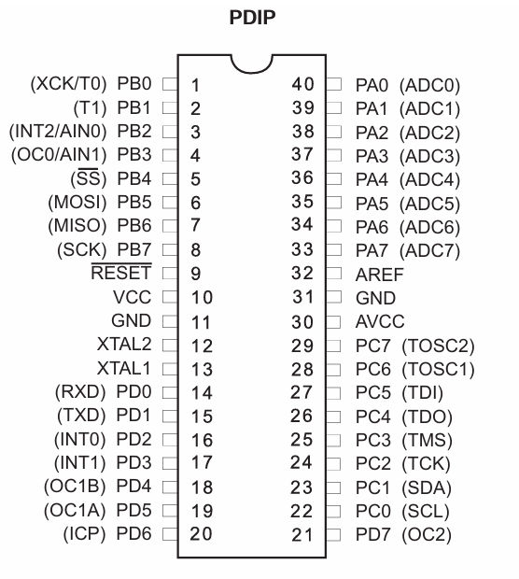
AVR® Microcontroller ATmega32
RISC Processor
High-performance
Low-power Consumption
Integrated Peripherals
32K Bytes In-System Programmable Flash

Slide 12
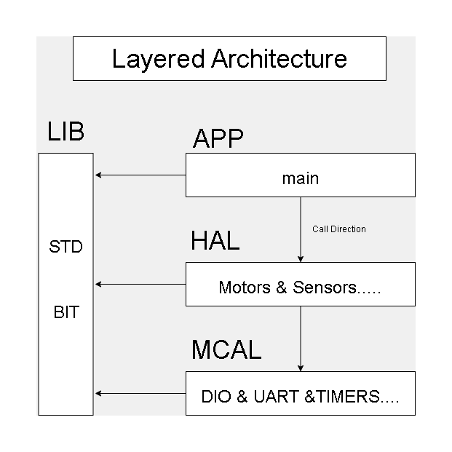
"Layered Design for Embedded Applications"

Slide 13
Smart Door Access Control
Allow users to remotely open and close the door using a mobile application.
Enhance convenience and security in the smart home system.

Slide 14
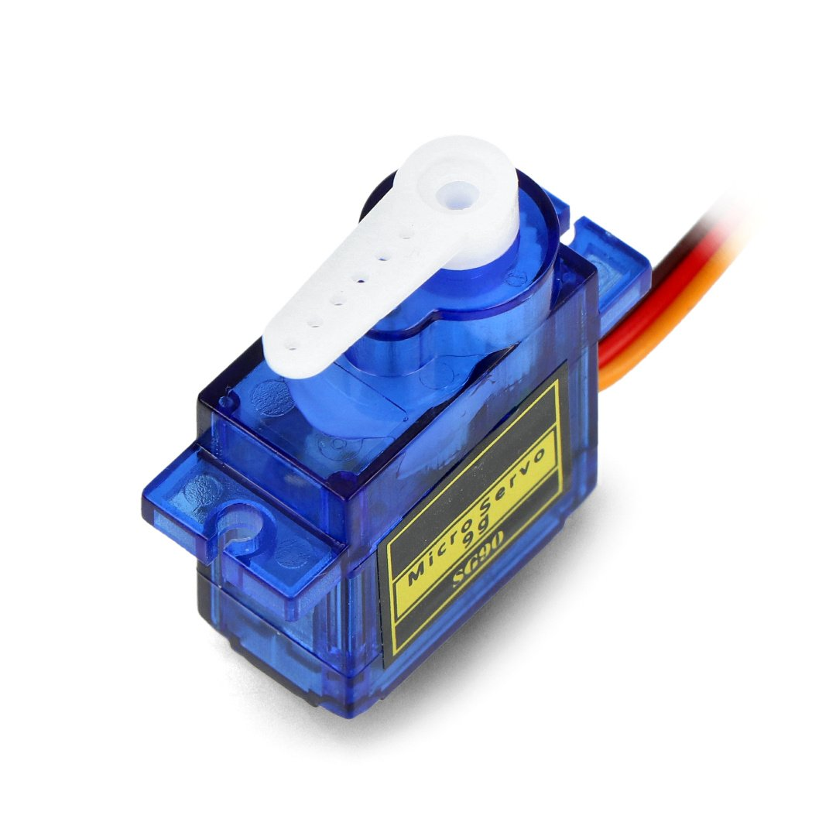
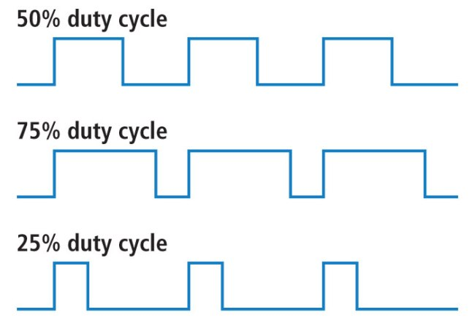
Door Control System
Servo Motor Working Principle:Controlled by PWM (Pulse Width Modulation) signals.
The angle of rotation is determined by the pulse width:
1 ms pulse width → Minimum angle
(e.g., 0°)
2 ms pulse width → Maximum angle
(e.g., 180°)

Slide 15
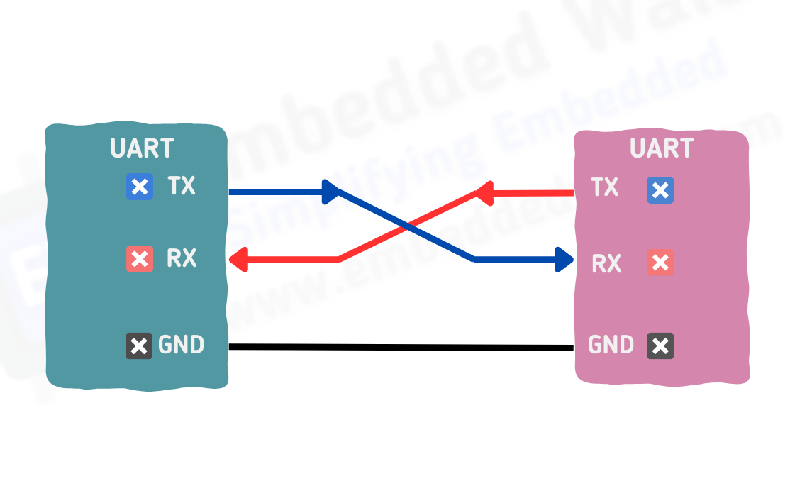
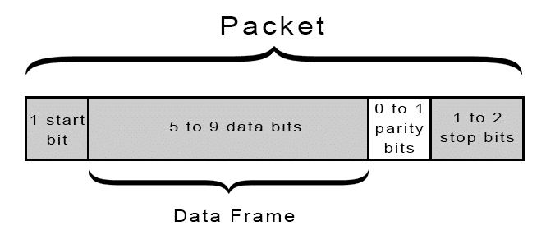
UART Communication Protocol
UART Specs
Serial
Asynchronous
Full Duplex

Slide 16
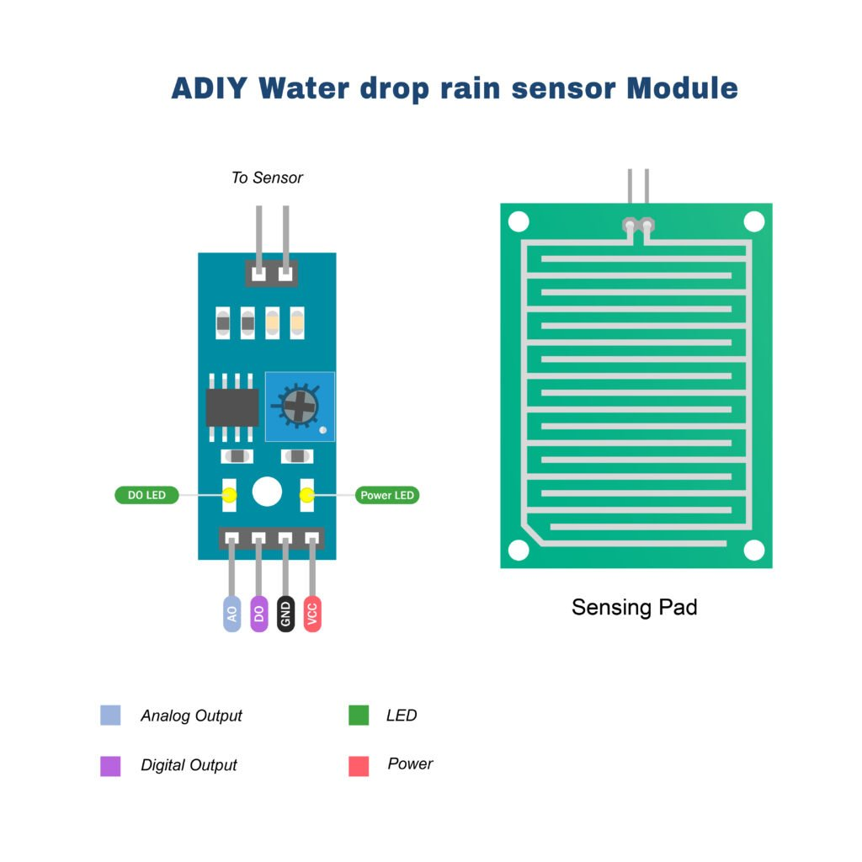
Rain Guard System
Description:
Automatically closes windows when rain is detected.
Operates using a rain drop sensor and servo motor.

Slide 17
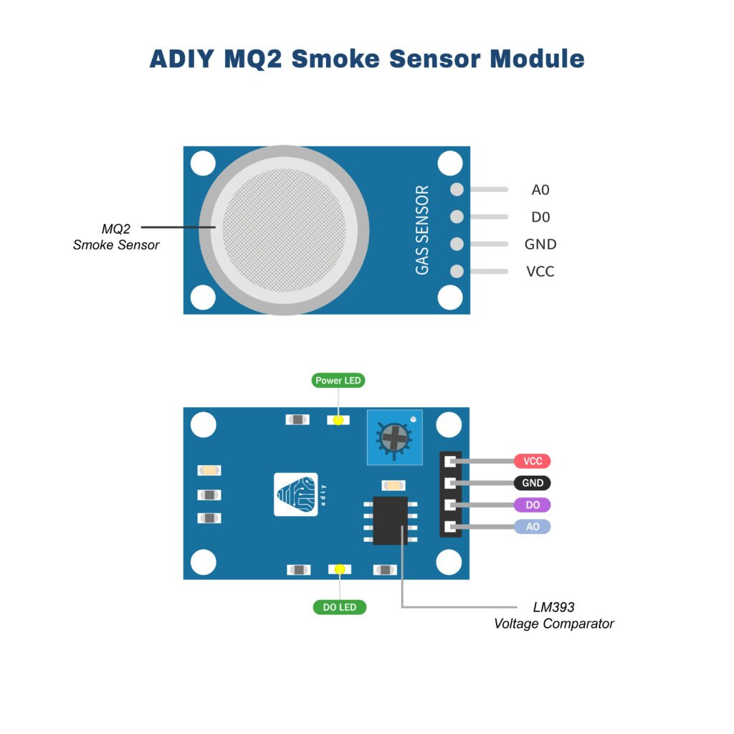
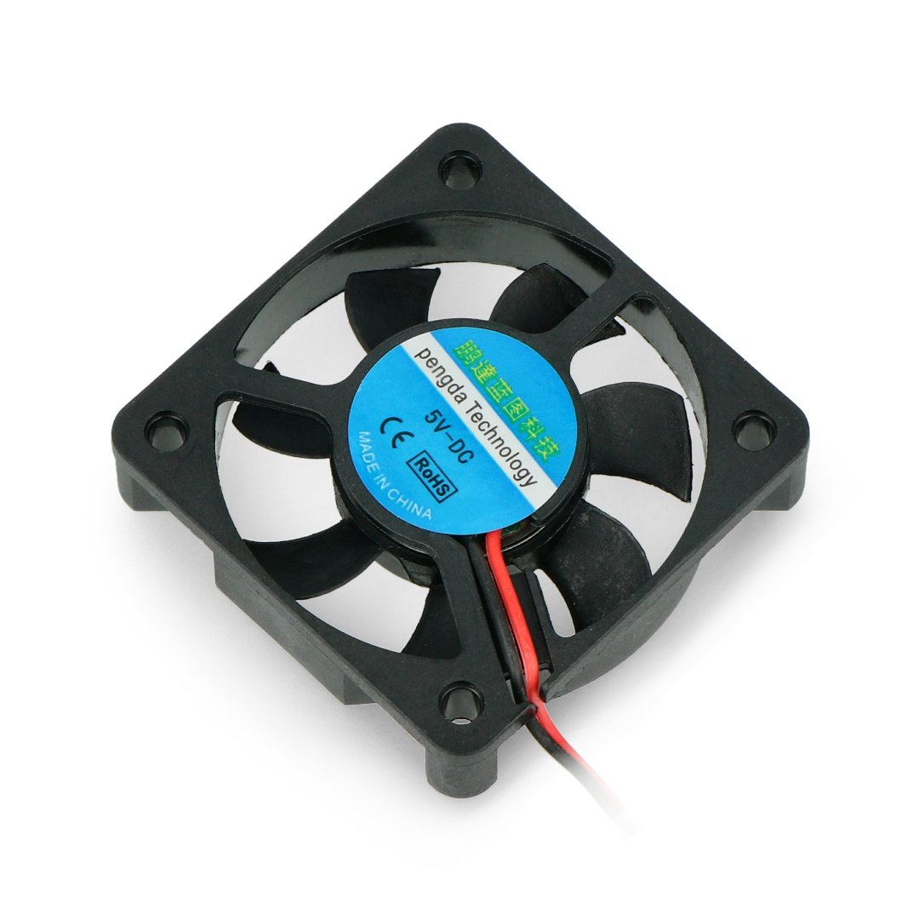
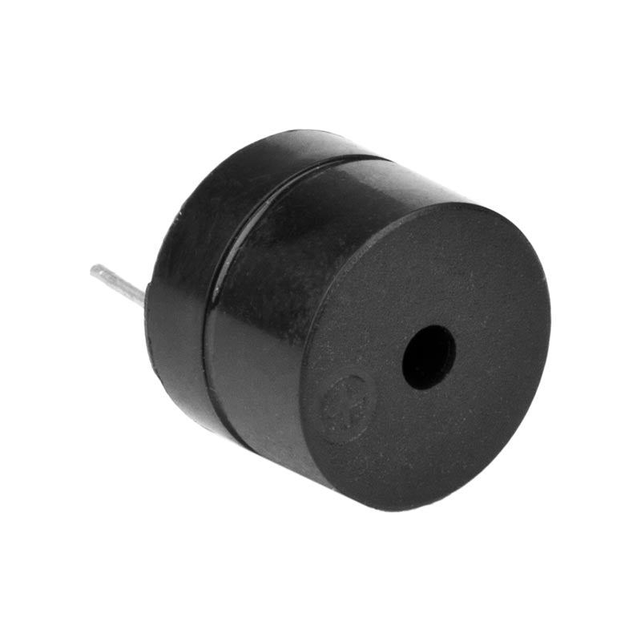
Smart Gas Detection
Description:
Detects gas leaks and activates a fan and buzzer for safety.
Uses an MQ-2 gas sensor.

Slide 18
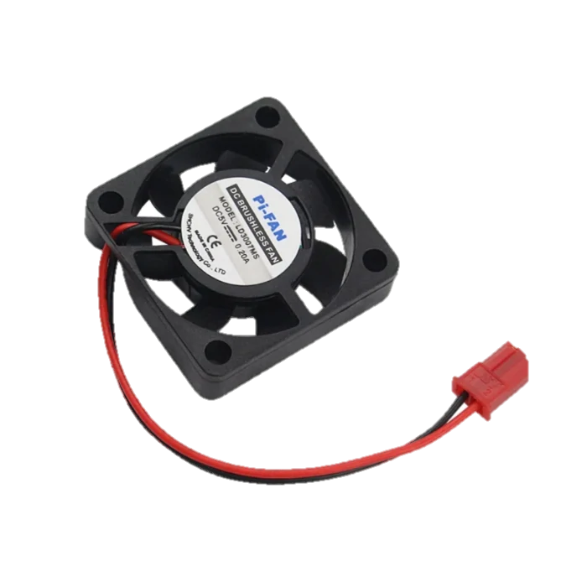
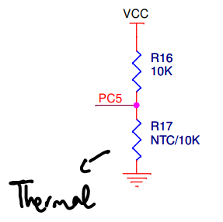
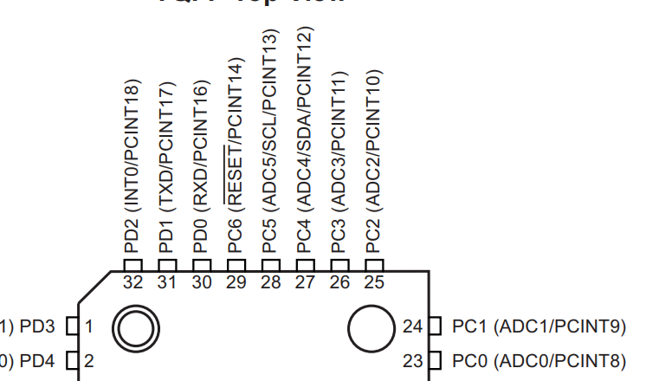




Temperature sensing with fan control.
PD3

Slide 19
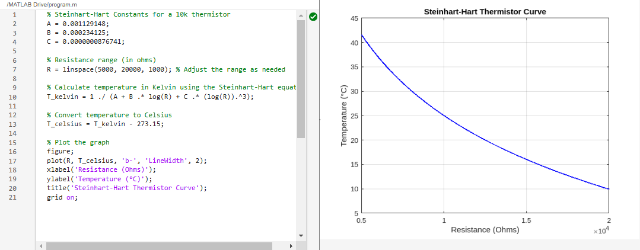
Temperature sensing with fan control.
Steinhart-Hart equation solving linearity problem

Slide 20
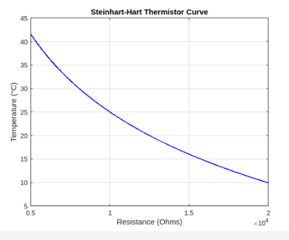
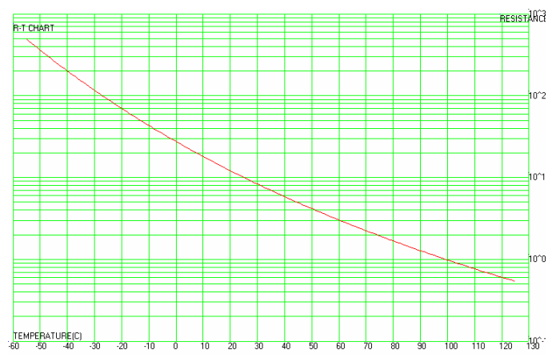
Temperature sensing with fan control.

Slide 21
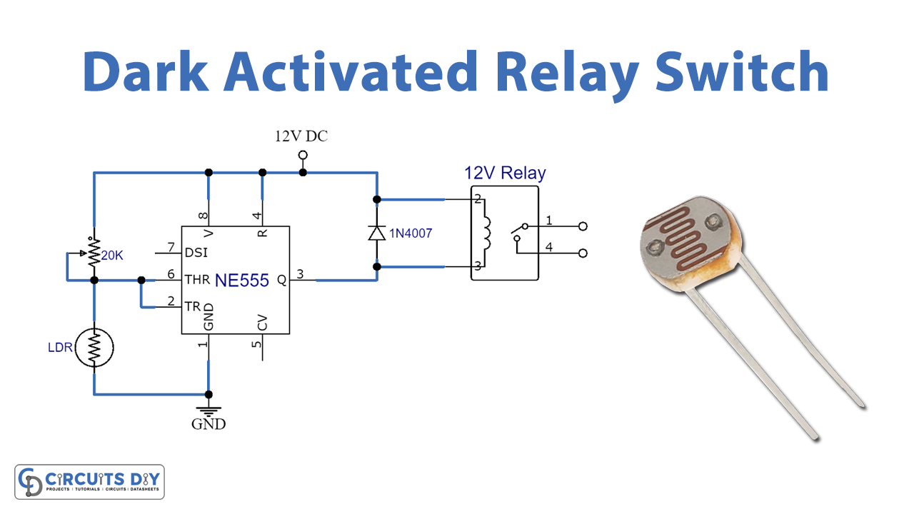
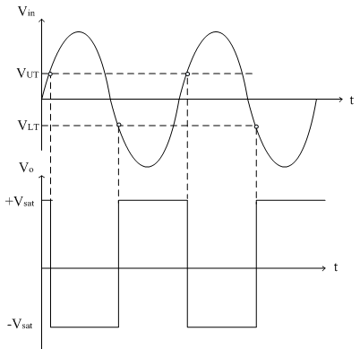
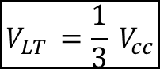
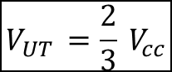
Dark activated system with solar charging system
Schmitt trigger
$$V_{UT }=\frac{2}{3} V_{cc}$$
light-sensitive applications, providing reliable and stable operation.
$$V_{LT }=\frac{1}{3} V_{cc}$$

Slide 22
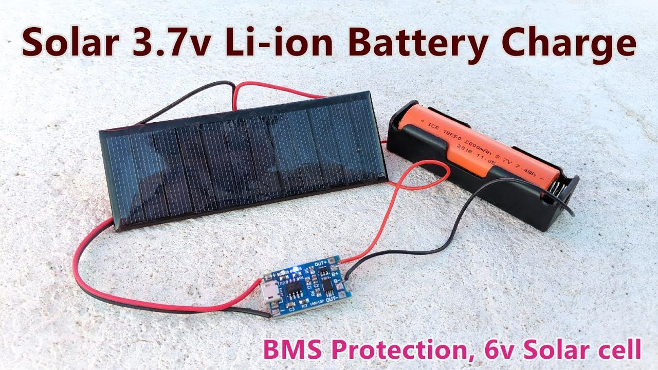

Dark activated system with solar charging system

Slide 23
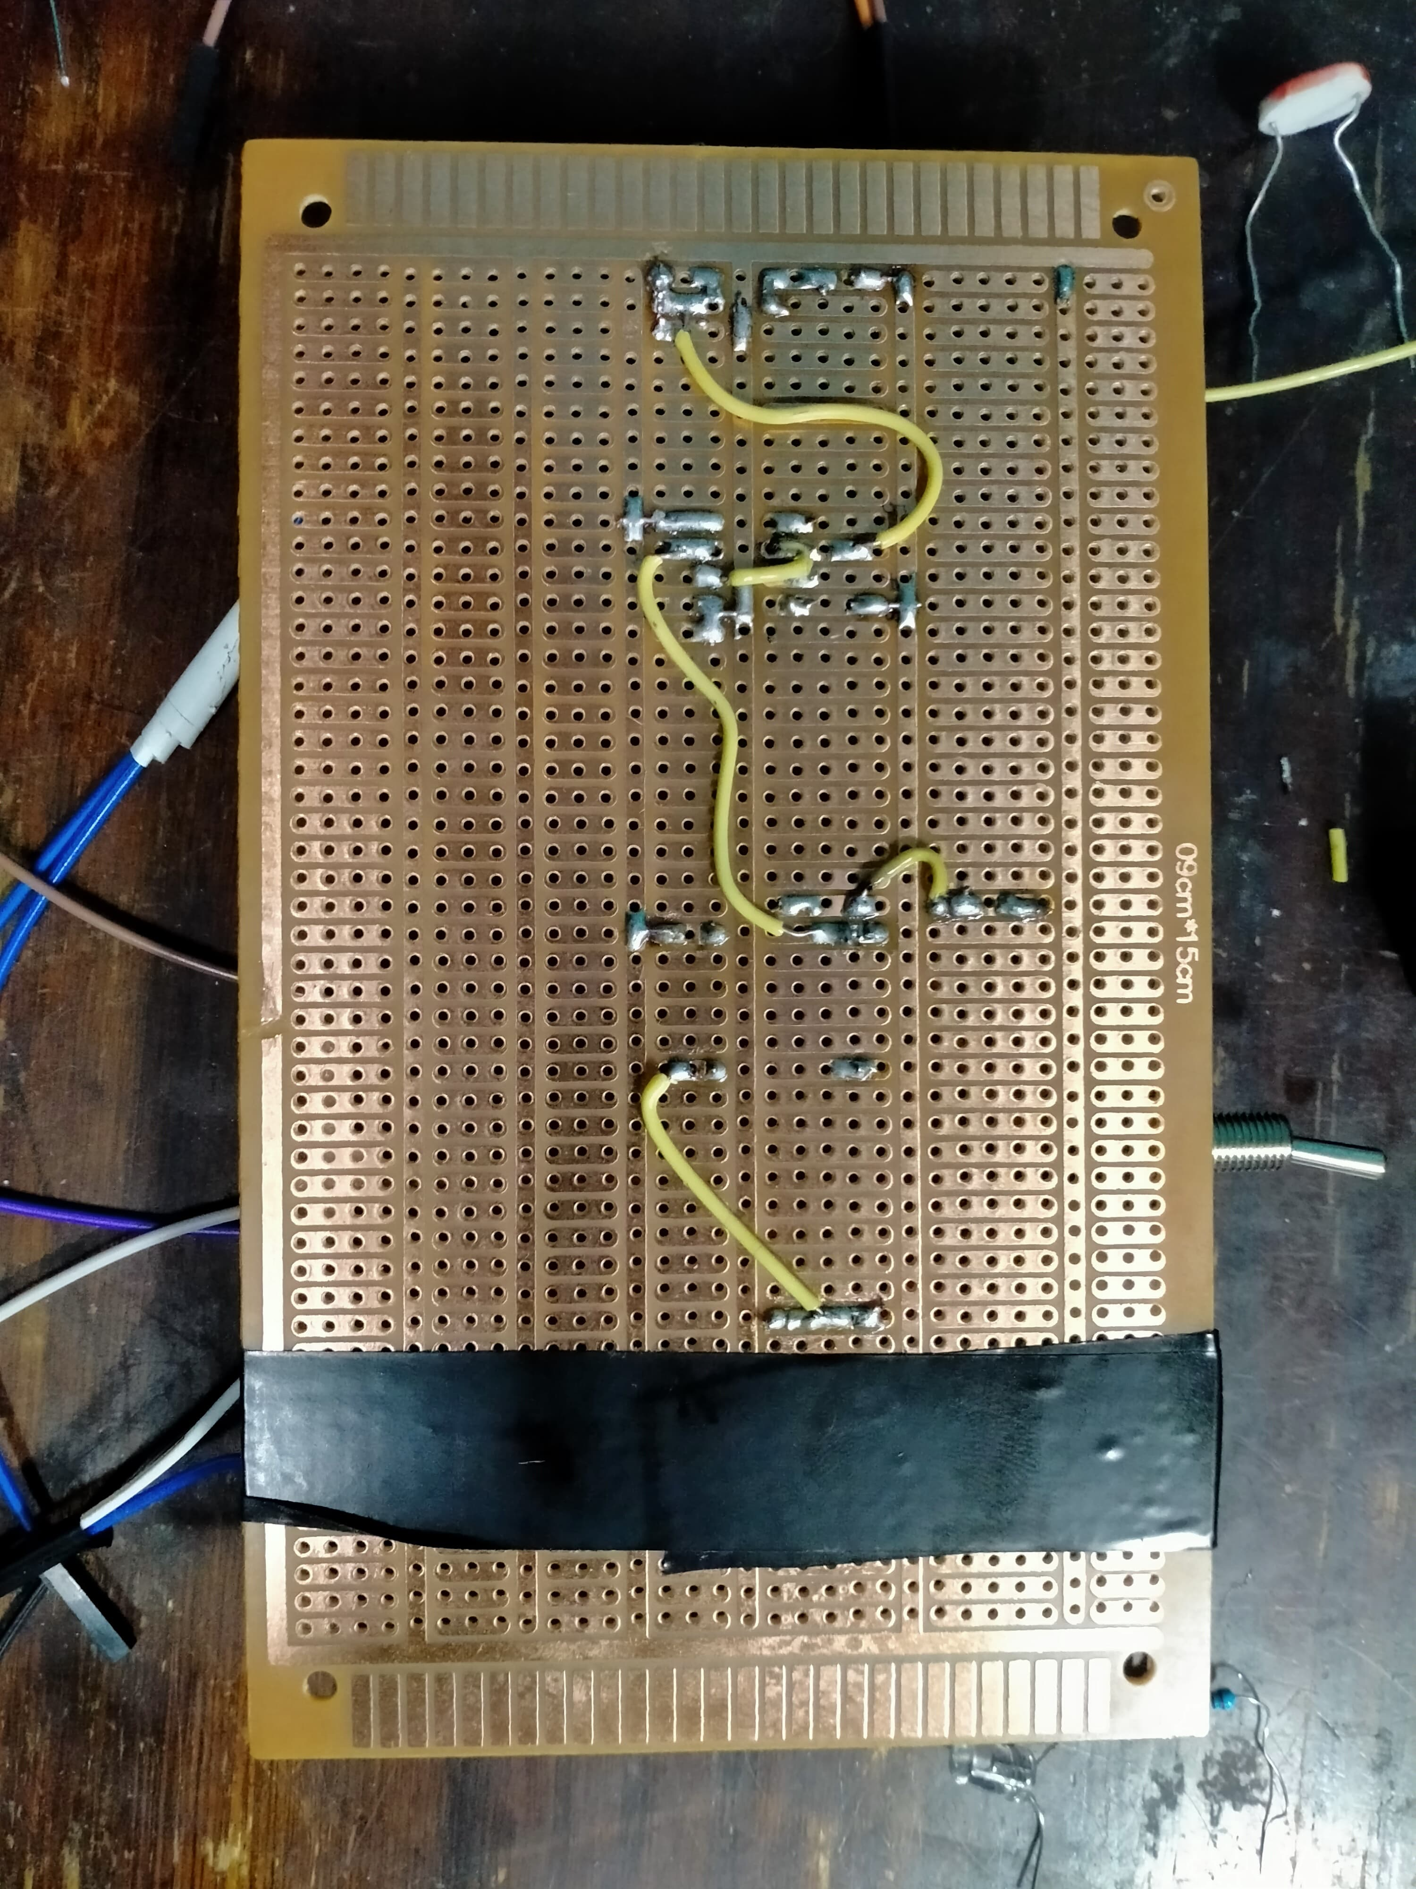
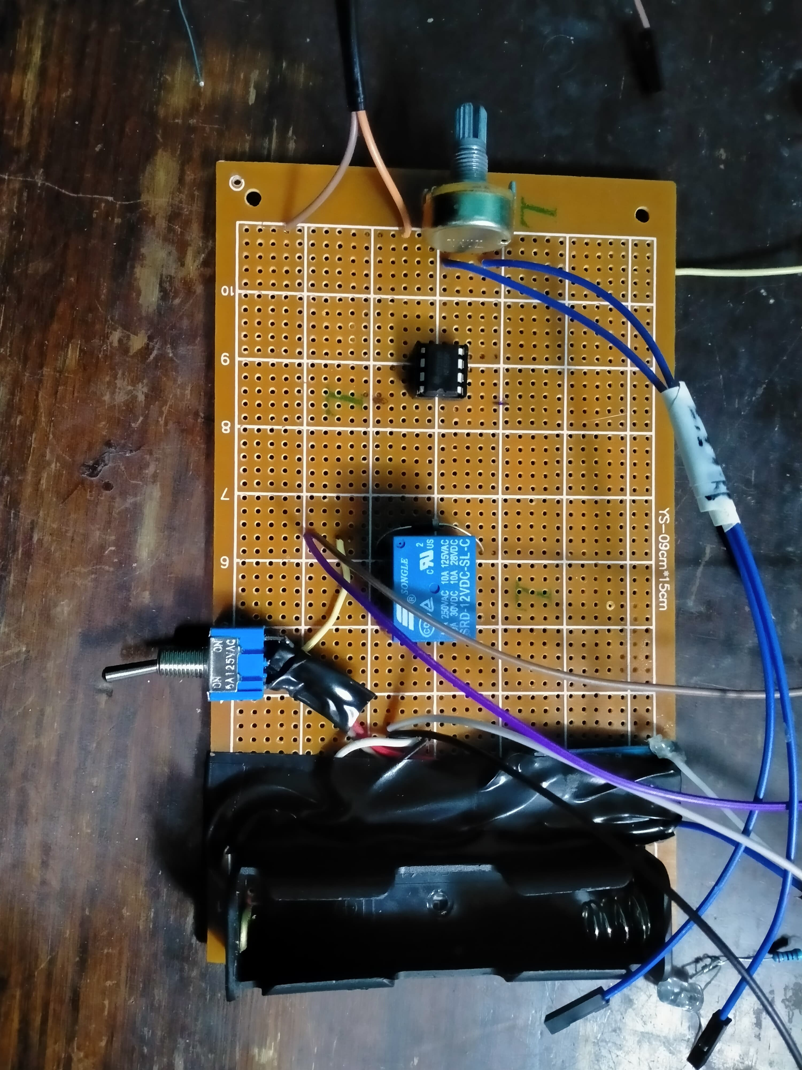
Dark activated system with solar charging system

Slide 24
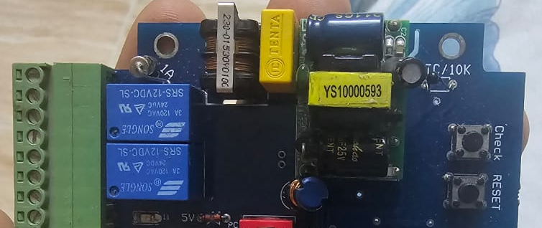
ATMEGA328P DC POWER PROBLEM

Slide 25
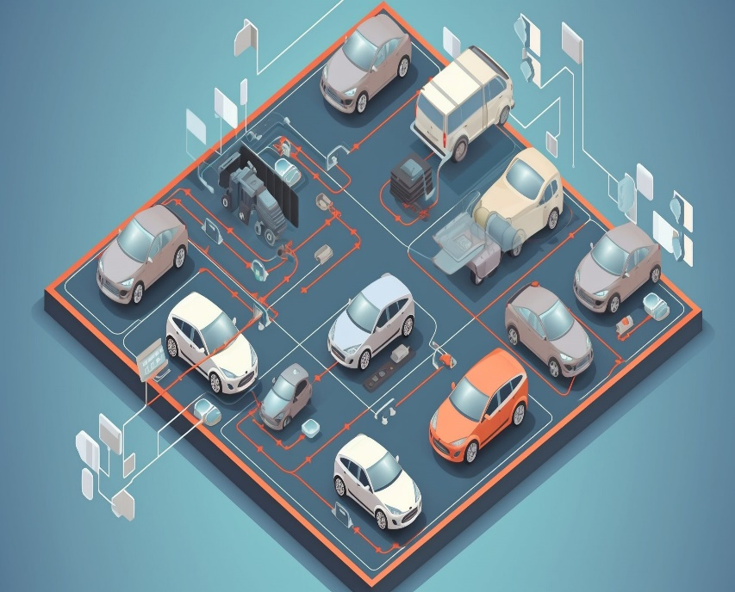


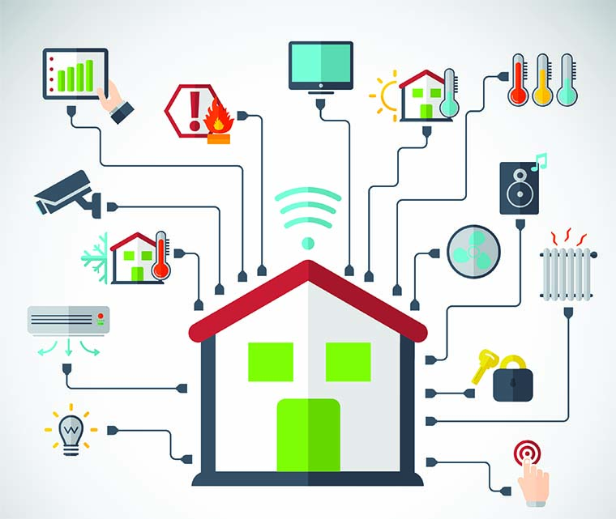
FOR SMART HOMES

Slide 26
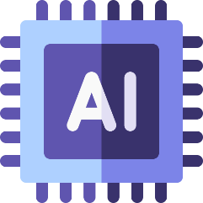
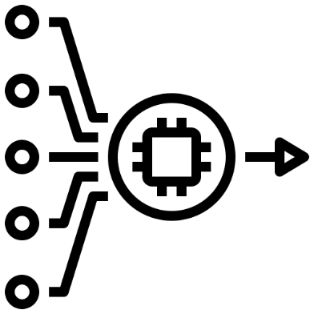





ARCHITECTURE

Slide 27

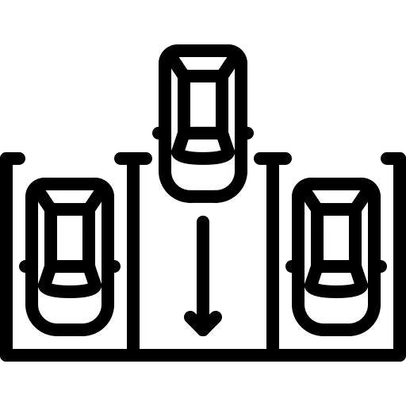
FACE ID ACCSESS
PARKING

Slide 28


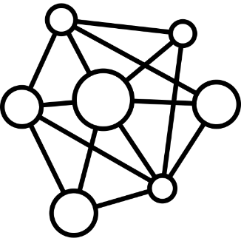



Requirements

Slide 29
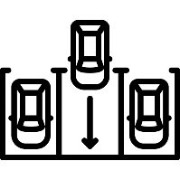
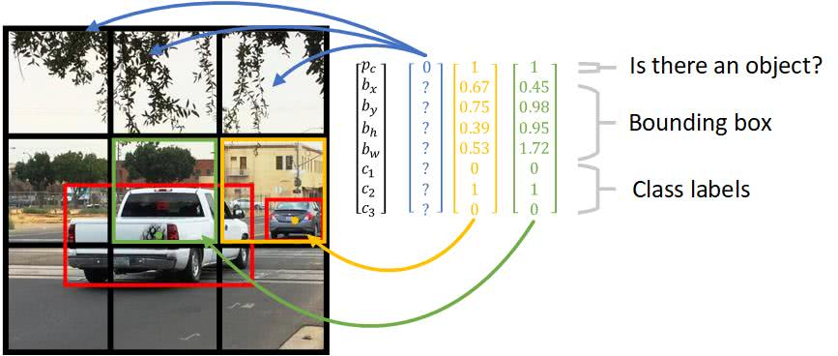
PARKING

Slide 30
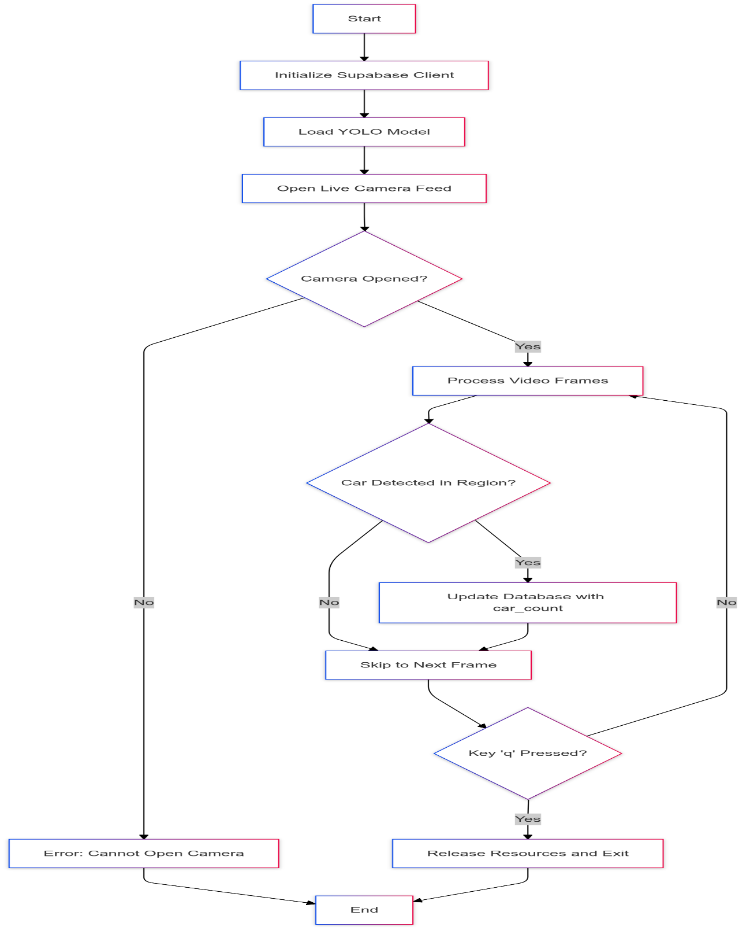
PARKING

Slide 31

PARKING

Slide 32
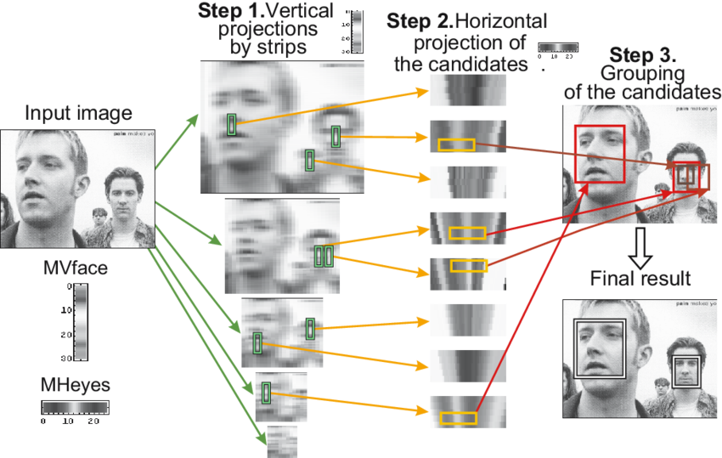
FACE ID ACCSESS

Slide 33
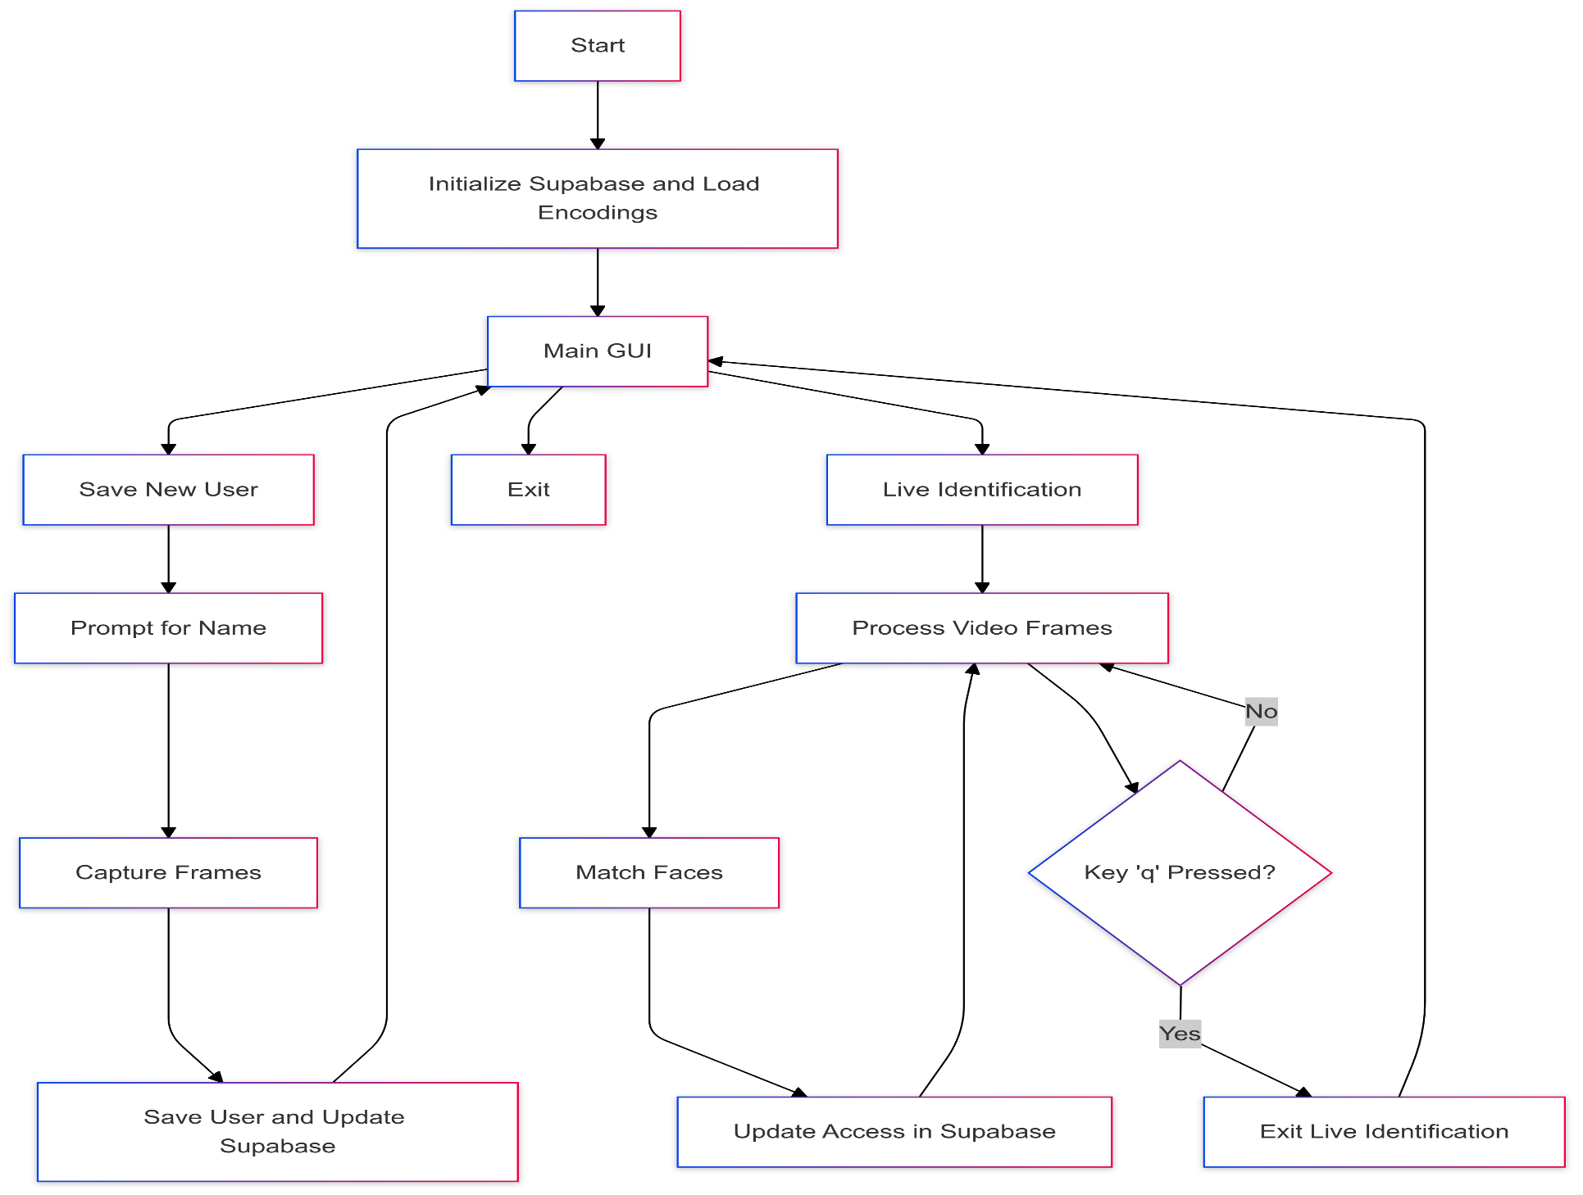
FACE ID ACCSESS
10

Slide 34
FACE ID ACCSESS
video

Slide 35

What is the Cloud?
The cloud is a technology that allows you to store data and run applications over the internet instead of using local devices or on-premises servers. It is essentially a vast network of servers distributed worldwide, providing services like storage, databases, computing, and more in a fast and secure manner.
Types of Cloud
Public Cloud
Private Cloud
Hybrid Cloud

Slide 36
Cloud Type Used in Our Project
we utilized a Public Cloud through the Supabase platform.
Q1: Why Supabase?
Offers free or low-cost services, ideal for students or initial projects.
Provides ready-to-use databases, APIs, and tools for storage and cloud functions easily.
Simplifies development and programming by focusing on simplicity and speed.
Q2: Why Not Paid Solutions like AWS or Google Cloud?
These platforms are expensive and unsuitable for the limited budget of the project.
Paid solutions offer additional features, but they are unnecessary for the scale and requirements of our project.

Slide 37
How Did the Cloud Help in Our Project?
1. Data Management:
All data collected from the garage or smart homes is stored directly on the cloud. This allows easy access to data from anywhere.
2. Flexibility:
The cloud enables us to modify, update, or even scale the system effortlessly without requiring additional infrastructure.
3. Speed:
With Supabase, operations such as storage, processing, and data retrieval are performed very quickly.
4. Security:
Although Supabase offers free services, it ensures a high level of data security, guaranteeing the protection of users' personal information.

Slide 38
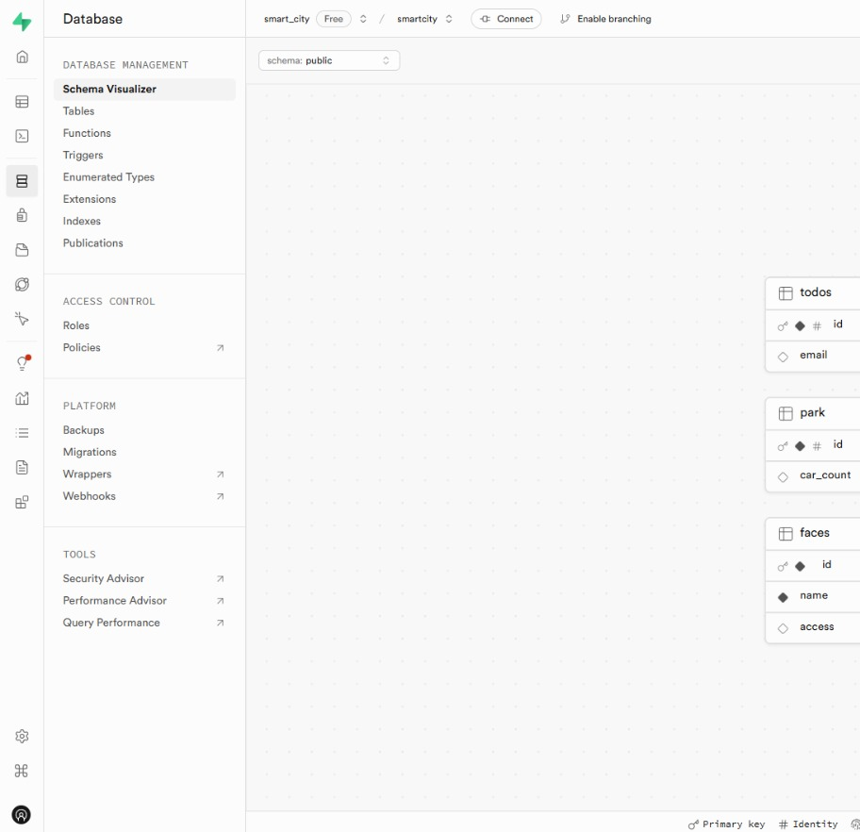
Supabase Cloud Functions with No Code Visually
Supabase Cloud Functions are one of the most valuable tools provided by the platform, enabling us to execute cloud functions efficiently and simply without complex coding. This feature is especially suitable for student projects or beginner developers who want to focus on the idea rather than technical details.
What are Cloud Functions?
They are essentially pieces of code that run on the cloud and perform specific tasks such as data processing, calculations, or API integrations. They operate independently in the background once triggered.
Why are Supabase Cloud Functions Different?
1. No Code/Low Code Approach
2. Easy Integration
3. High Performance

Slide 39

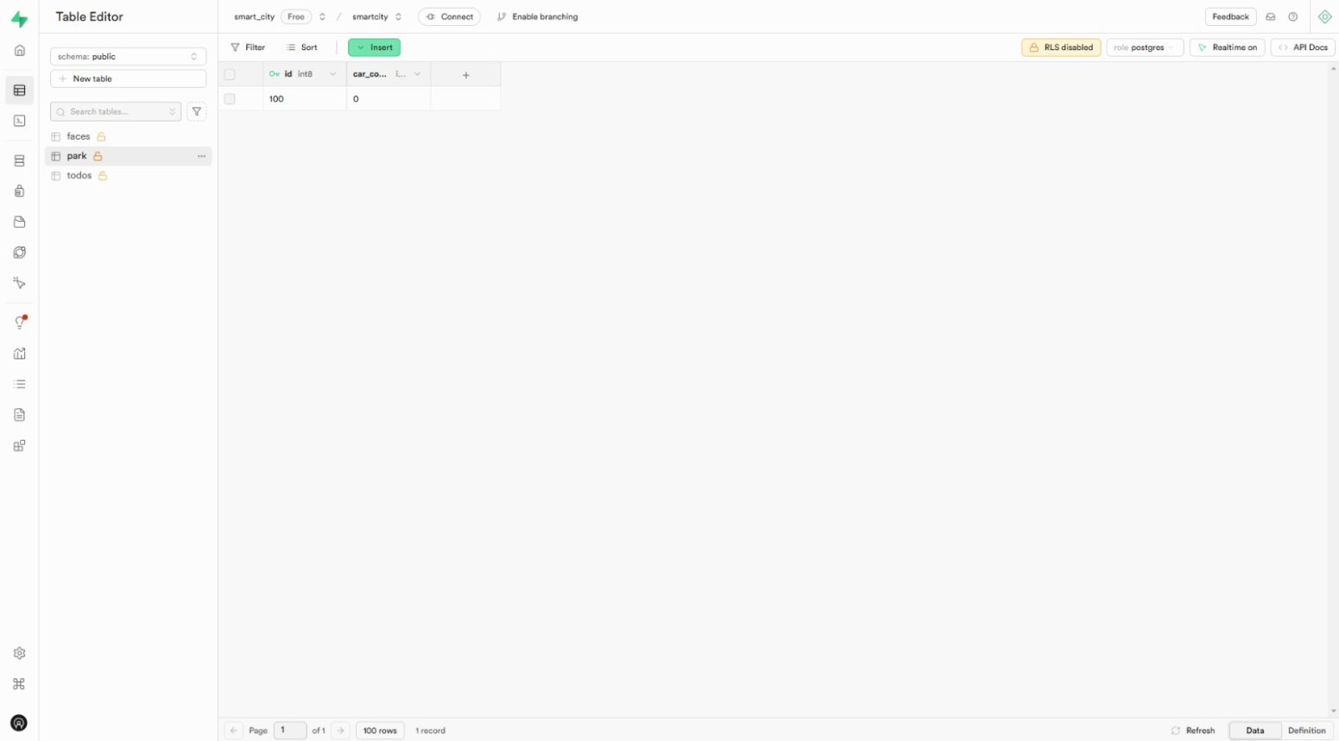
How Did We Use Cloud Functions in Our Project? we utilized Cloud Functions to achieve two main functionalities:
Vehicle Counter in the Garage
When a car enters, the camera captures an image, and the cloud function processes the image to determine whether a new car has entered or exited.
The function updates the database in real time to display the number of available spaces.

Slide 40
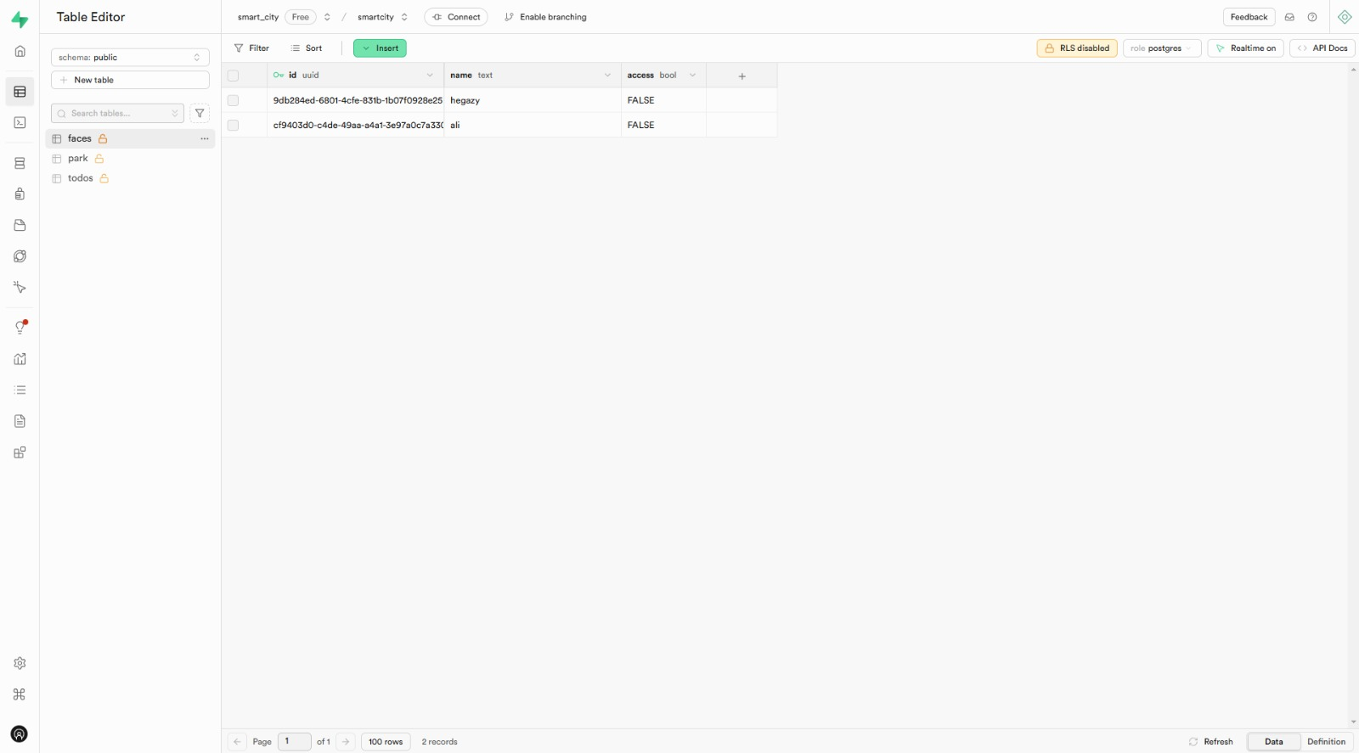

2. Face detection system
Cameras in smart homes capture images of visitors.
The cloud function compares the image with a database of registered faces.
If the face is recognized, the door opens; if not, a notification is sent to the user.

Slide 41
Steps to Build Functions Using Supabase
1) Function Creation:
Using the Supabase dashboard, specify the function you want to build (e.g., vehicle counting).
2) Integration with Databases:
The function interacts directly with the database to either add new data or modify existing data.
3) Function Execution:
Functions can be triggered through the application or automatically based on events (e.g., new data entry).

Slide 42
Benefits We Gained from Cloud Functions
Faster Development: Functions were ready in a much shorter time compared to traditional methods.
Reduced Errors:
The visual interface helped us avoid programming errors that might occur with manual coding.
Cost Efficiency:
Supabase provided these services either for free or at low costs, which was ideal for our project budget.

Slide 43
Mobile Application
Outlines:
Technologies Used
Offline Availability
App User Flow
MVVM

Slide 44



Technologies Used
Flutter
Supabase SDK
HTTP

Slide 45
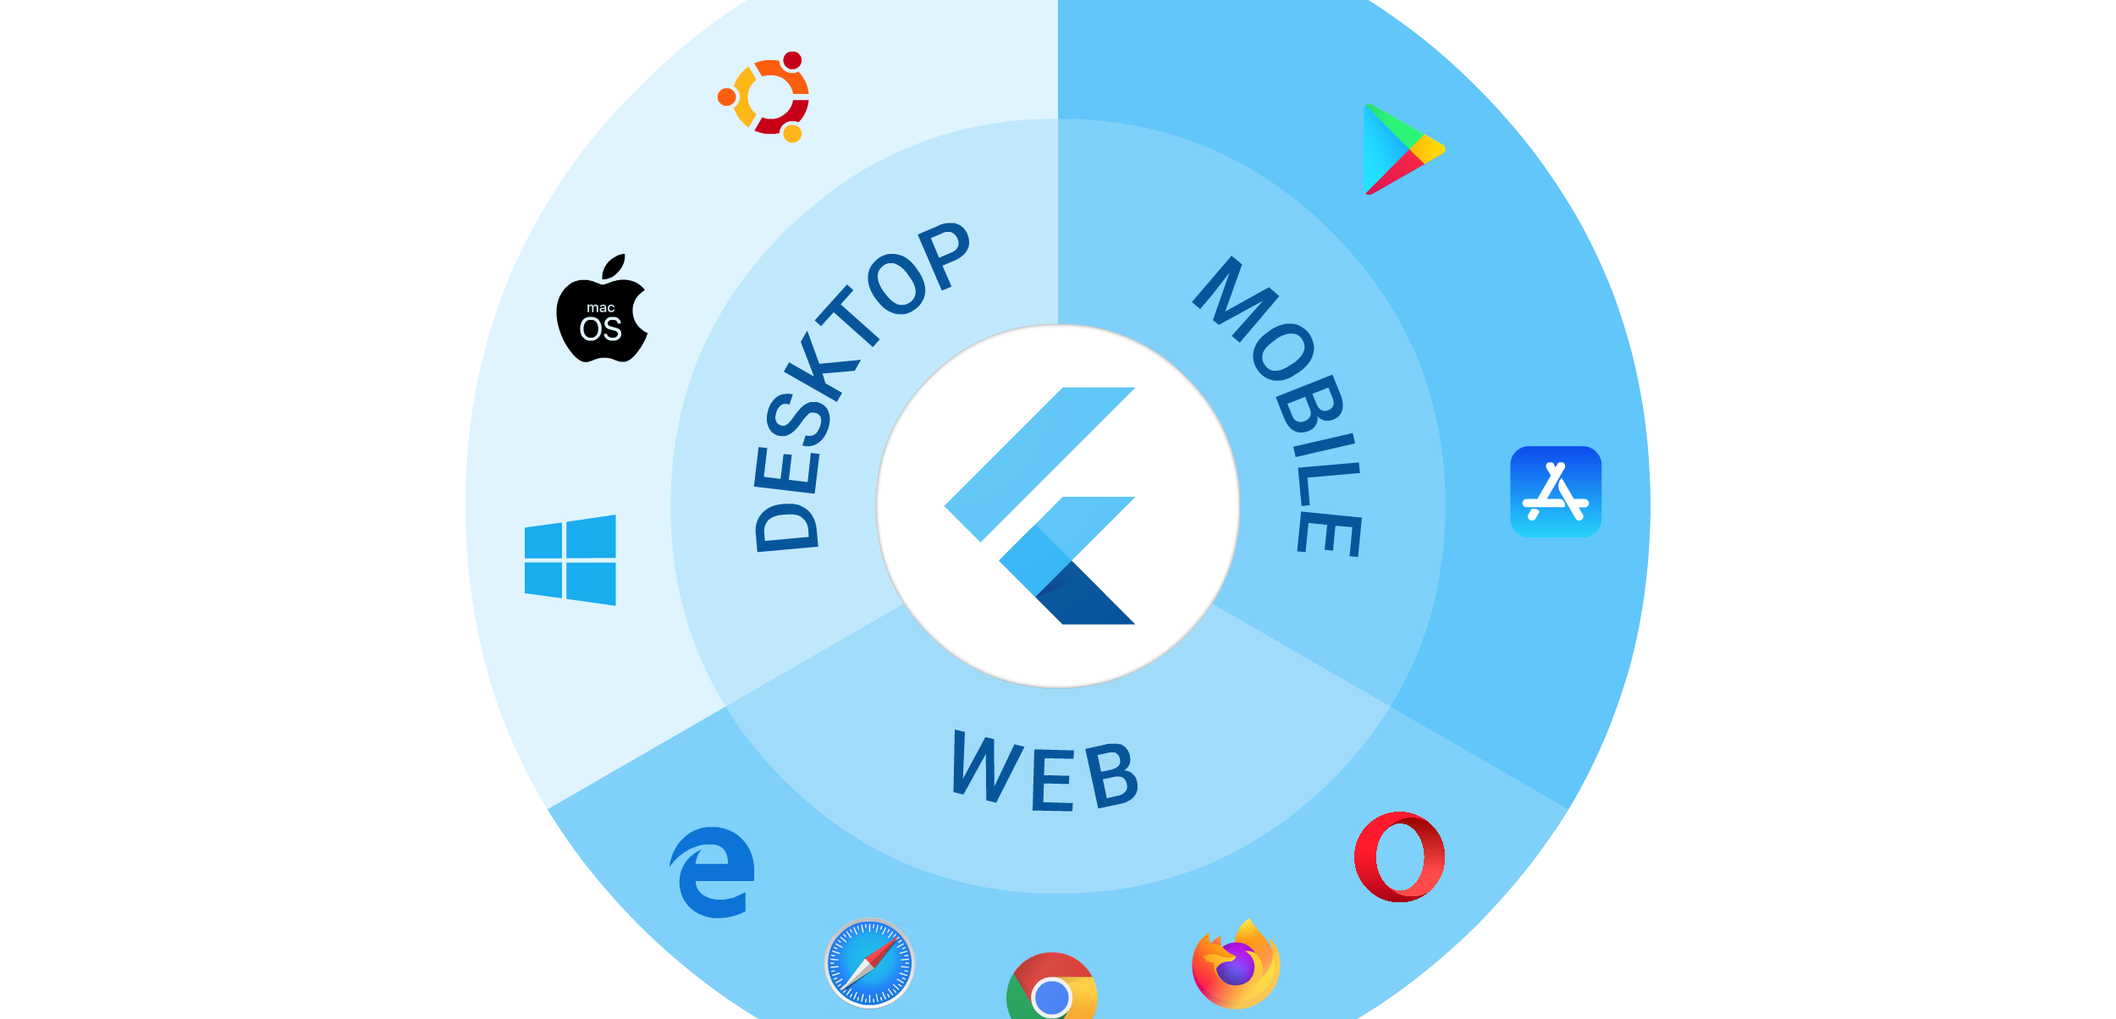
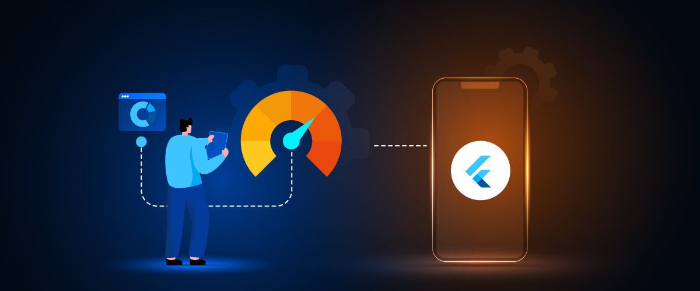
Flutter
Features: Cross Platform
Performance Optimization

Slide 46
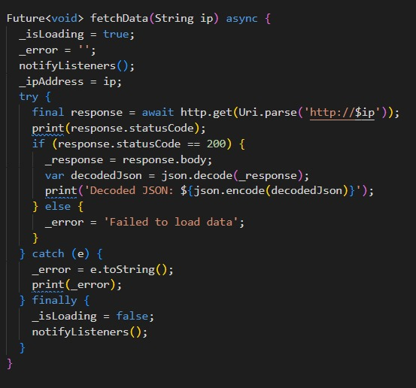

Offline Availability
Using HTTP Requests directly to WiFi Module

Slide 47

Supabase SDK
Connecting to Supabase Cloud to send and receive data for Home System

Slide 48

MVVM

Slide 49

App User Flow

